Slide 1















Small Office Network
Infrastructure & Cybersecurity Track
CCNA (GIZ1_ISS2_M1d)

Slide 2
Supervised by:
Islam Edrees
Team members:
Kirollos Magdy Eskander Zaky
Mahmoud Abdelaty Hassan Ahmed
Mahmoud Elsayed Mohamed
Mina Samy sobhy
Mostafa Saied Ahmed Omran
Yousif Anwar Abdelrahman Mohamed

Slide 3
Introduction
Designing a small office network involves creating a reliable and efficient system that connects various devices within the office to facilitate communication and resource access.
A well-designed network can improve productivity, enhance collaboration, and streamline operations within the office environment.

Slide 4
Introduction
Key considerations in small office network design include selecting the appropriate networking devices (like routers, and switches) ensuring and planning for scalability to accommodate future growth.
By carefully planning and implementing a small office network design, businesses can establish a robust infrastructure that supports their daily operations and enables seamless connectivity among employees, devices, and resources.

Slide 5
Project
Process
01
02
03
04
Planning and Design
(users, devices)
Configuration of Basic Devices
(switches, routers)
Advanced Configuration
and Testing
(inter-VLAN,
verify connectivity)
Documentation and Presentation

Slide 6

3 Access Switches
(2960-24TT)
2 Uplink Interfaces
24 Ports
1 Core Switch
(3560-24PS)
24 Ports
2 SFP-based GE
Network
Design
1 Router
(ISR 4331)
3 On board WAN
9 Telephone IP
9 PC

Slide 7
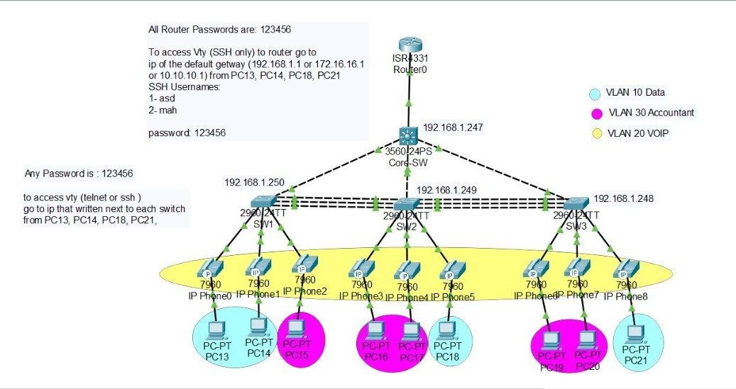
Network Design

Slide 8
VLANS
Virtual Local Area Network. It is a method of logically segmenting a physical network into multiple distinct broadcast domains, where devices within the same VLAN can communicate with each other as if they are on the same network, regardless of their physical location.

Slide 9
VLANS
Key points about VLANs:
Segmentation
Security
Broadcast Control
Flexibility
scalability
Inter-VLAN Routing
VLANs provide a powerful tool for network administrators to optimize network performance, and enhance security.

Slide 10
VLANS
Key points about VLANs:
Segmentation
Security
Broadcast Control
Flexibility
scalability
Inter-VLAN Routing
VLANs provide a powerful tool for network administrators to optimize network performance, and enhance security.

Slide 11
Spanning Tree Protocol (STP)
Definition: A protocol that prevents network loops by disabling redundant links in a network topology.
Benefits:
Prevents network loops
Improves network stability
Provides redundancy

Slide 12
Ether Channel Group (Port Aggregation Protocol - PAgP)
Definition: A protocol that prevents network loops by disabling redundant links in a network topology.
Benefits:
Prevents network loops
Improves network stability
Provides redundancy

Slide 13
Telephone Over IP
Telephone over IP, also known as VoIP (Voice over Internet Protocol), is a technology that allows voice communication and multimedia sessions to be transmitted over the internet rather than traditional telephone lines

Slide 14
4 PC - VLAN No. 10
5 PC - VLAN No. 30
VLANS
9 IP Phone - VLAN No. 20

Slide 15
VLANS

Slide 16
Access & Core Switches
Access switches are located at the network's edge and connect end-user devices such as computers, printers, IP phones, and access points to the network.
Core switches are positioned at the core or backbone of a network and are responsible for high-speed data switching within the network.

Slide 17
Switches & Router
Routers are networking devices that connect multiple networks and route network traffic between them. They operate at the OSI model's network layer (Layer 3).
Switches are networking devices that connect devices within the same network and facilitate communication within that network. They operate at the OSI model's data link layer (Layer 2).

Slide 18
Any Questions

Slide 19
Thank you

